Slide 1
Visualization in ML

Slide 2
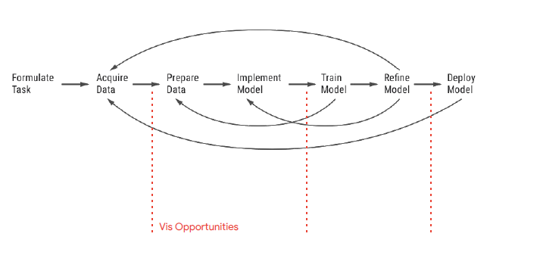
Opportunities for Vis in Machine Learning

Slide 3
Possible uses
Training data https://pair-code.github.io/facets/
Model performance: Tensorflow, AUC vs ROC
Interpretability + model inspection Activation atlases (min 2.30), Neural Networks
High-dimensional data Projector tensorflow
Communication

